Slide 1
Entrepreneurs Research
Researchers:
print(f‘{Jane_Wallace}, {Tanique_Adams}, {Menard_Tchatchou}, {Charleen_Carr}’)

Slide 2
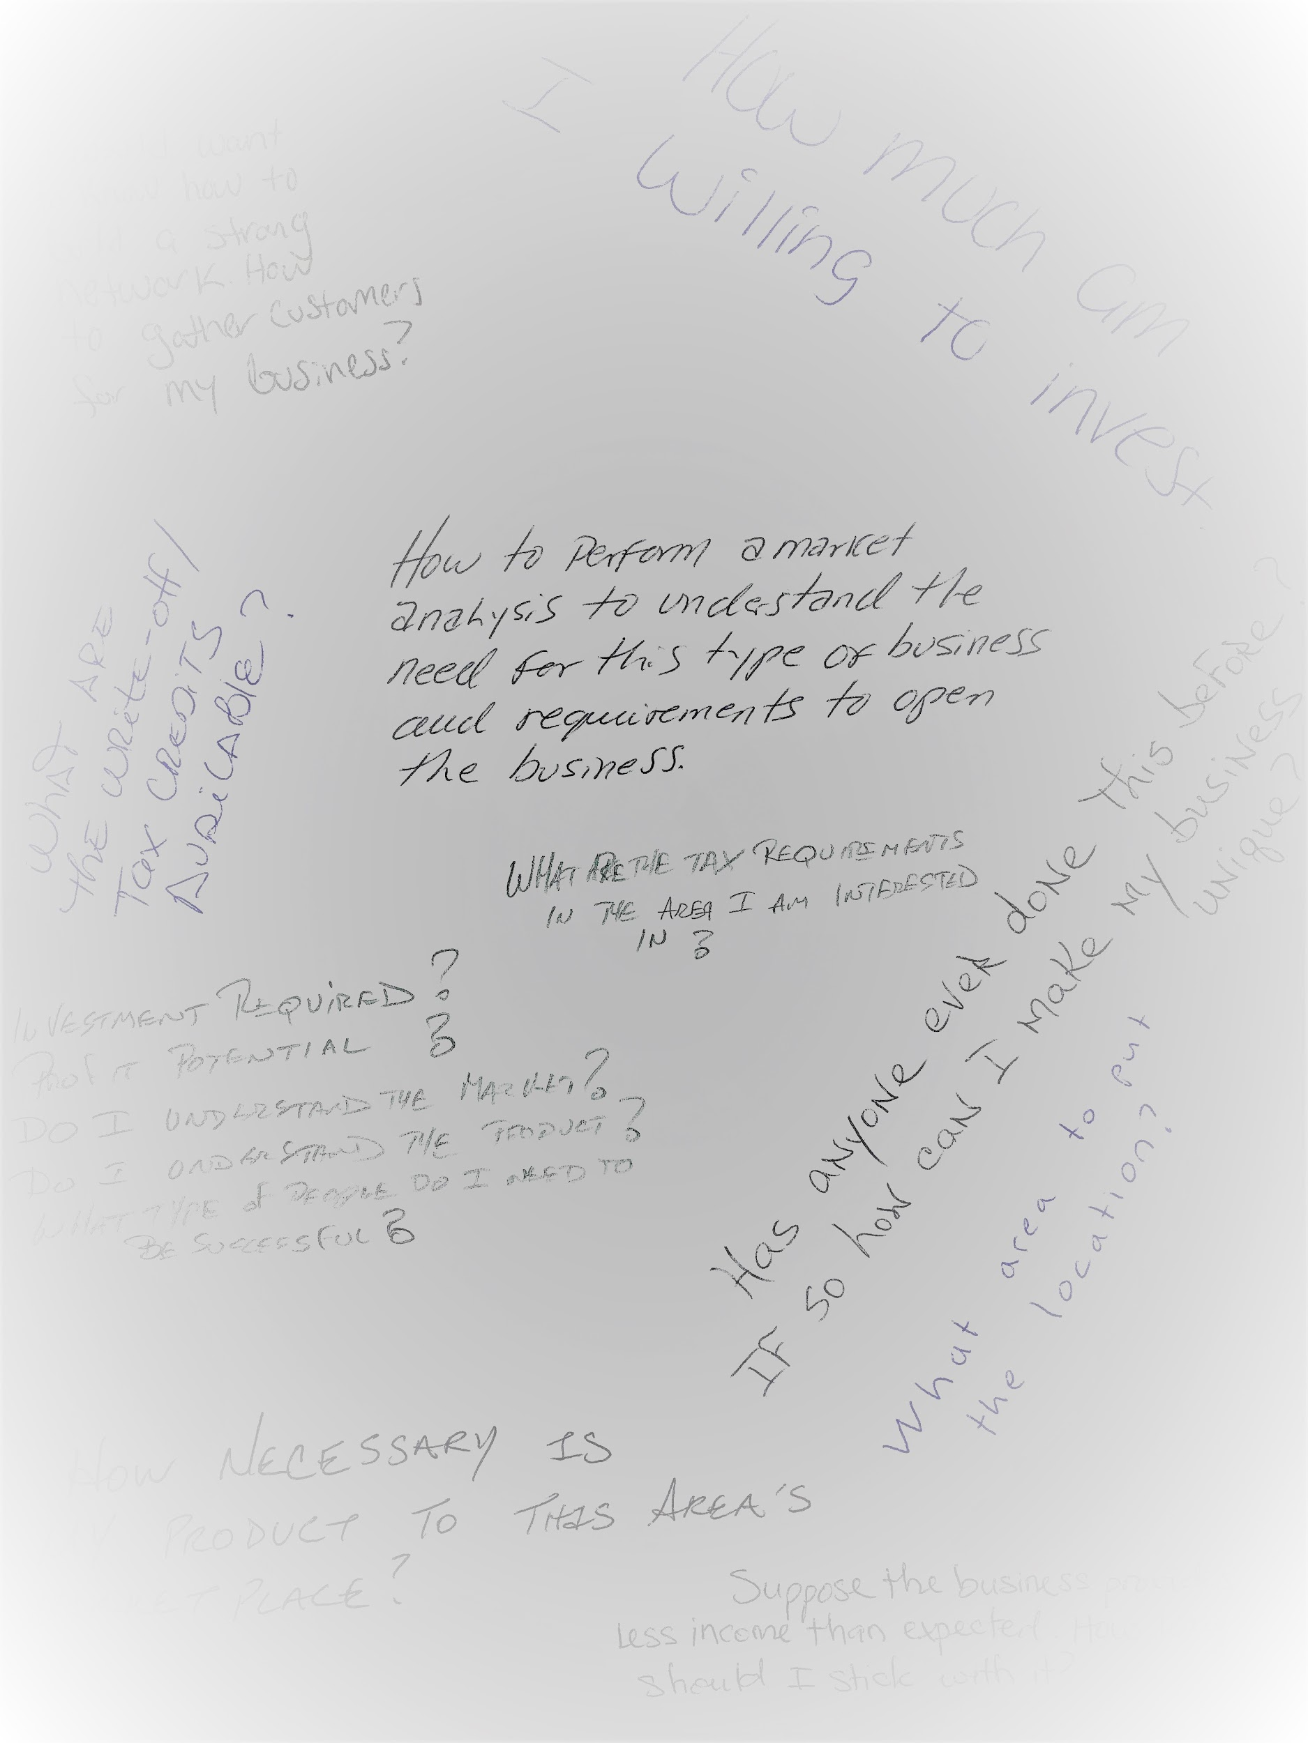
Project Objective
Assist entrepreneurs
to identify potential locations
for potential businesses

Slide 3
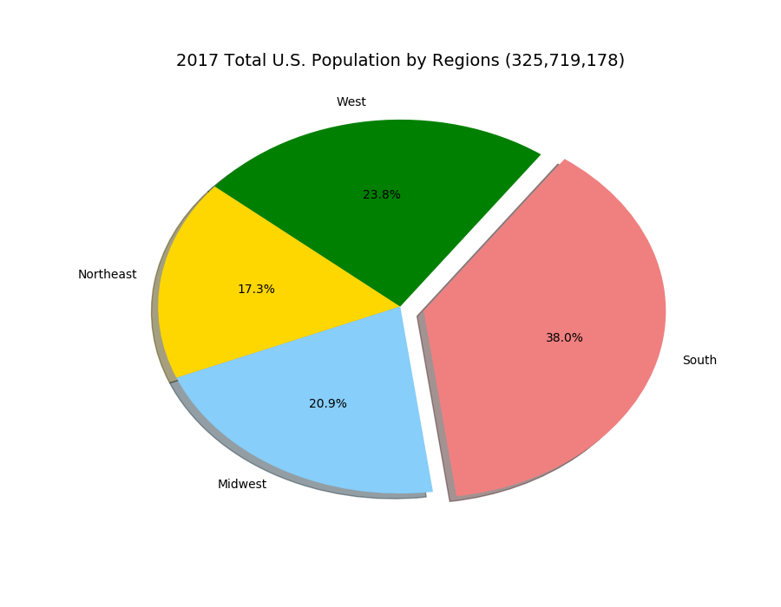
{Population Pie Chart 2017}

Slide 4
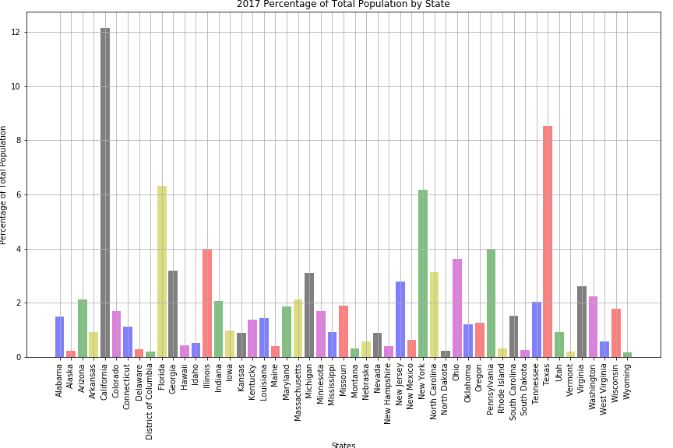

Slide 5
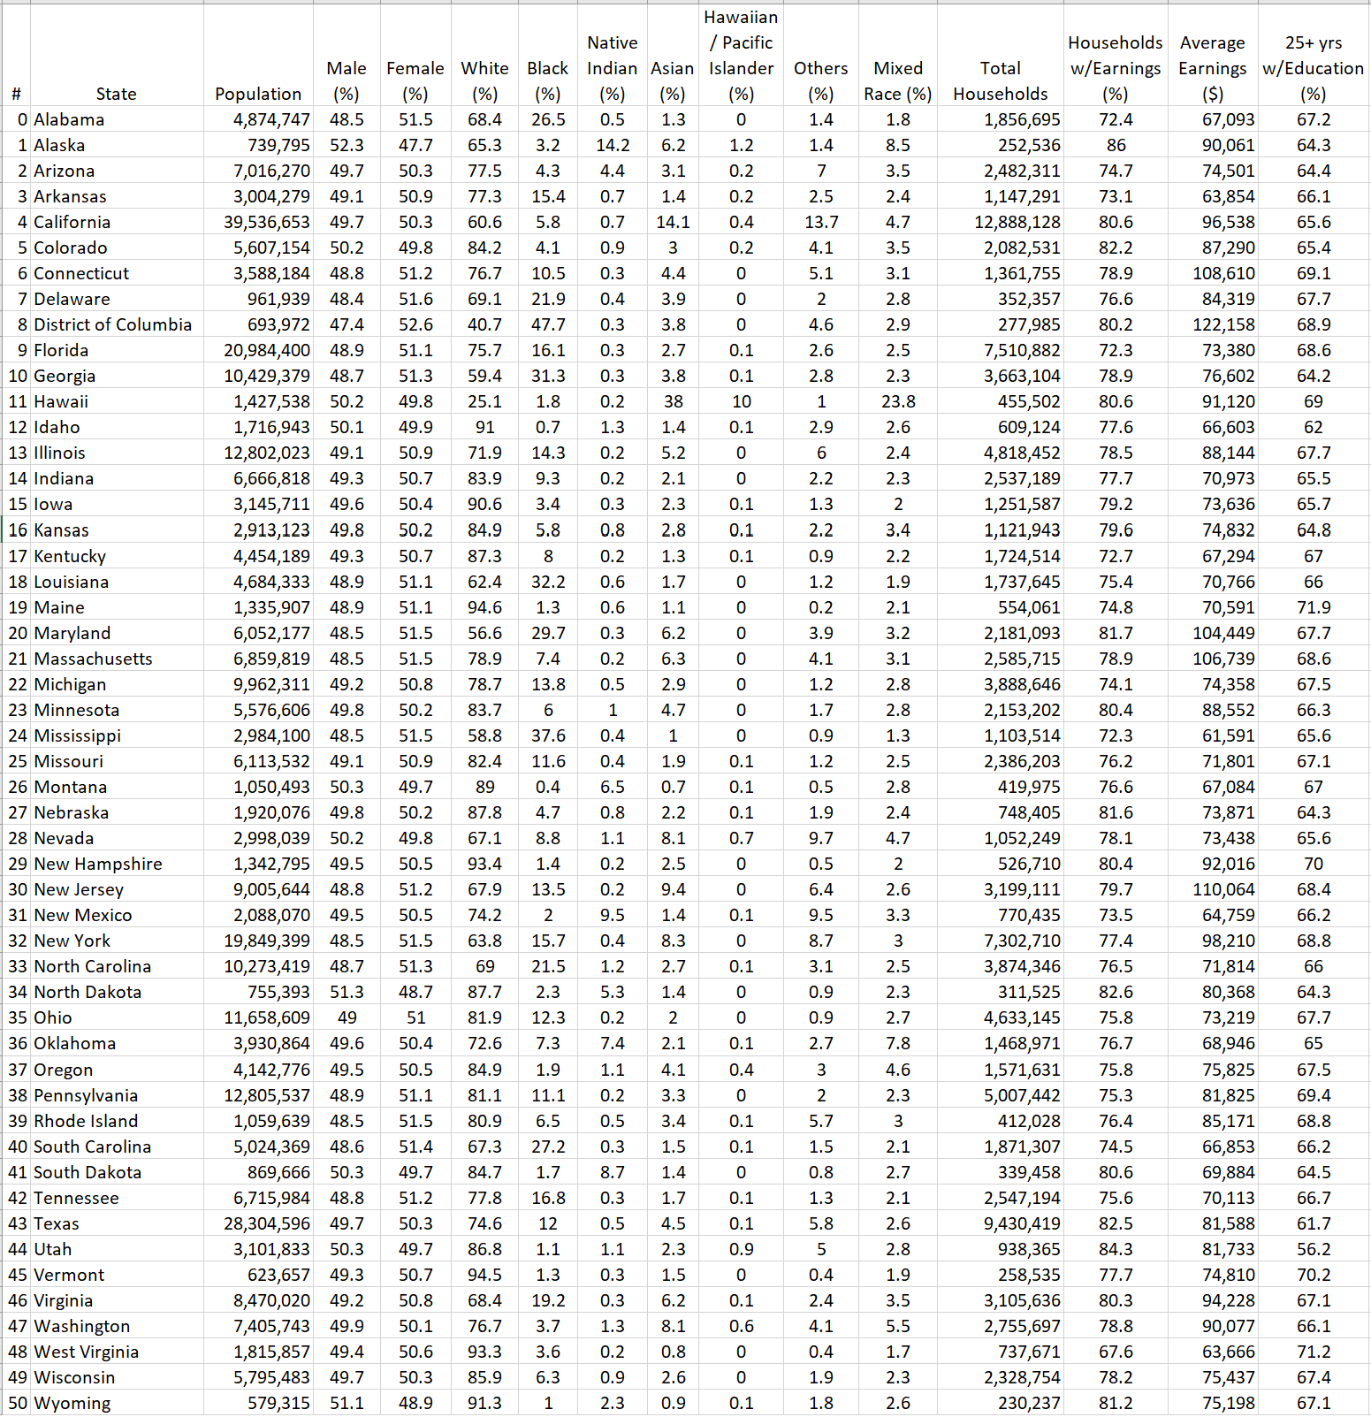
2017
Demographic
by States
Population
Gender
Race
Household
Income
Education

Slide 6
Case Study – Home Cleaning Service
Which states have the most wealthy people?
Which states have the most educated people?
Which states have the most female population?
Which states have the safest neighborhood in the US?
Which states have the most or least businesses?

Slide 7
Case Study – Home Cleaning Service
Five states with the highest average household income
Five states with the most educated people
Five states with the highest female population
Five states with the lowest crime rate
Five states with the least or most businesses

Slide 8
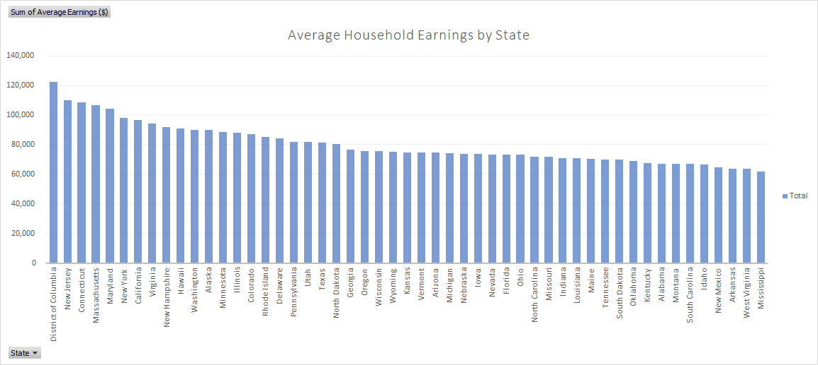

Slide 9
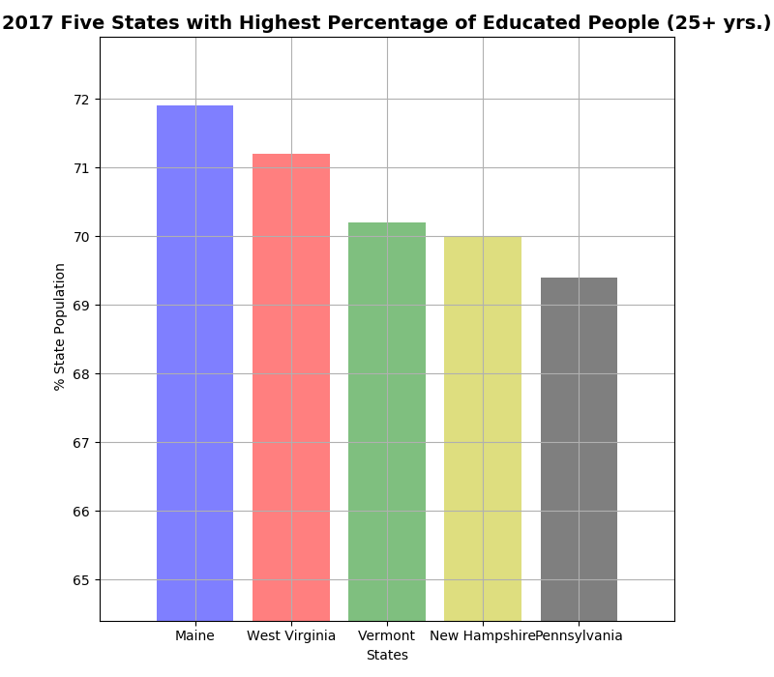

Slide 10
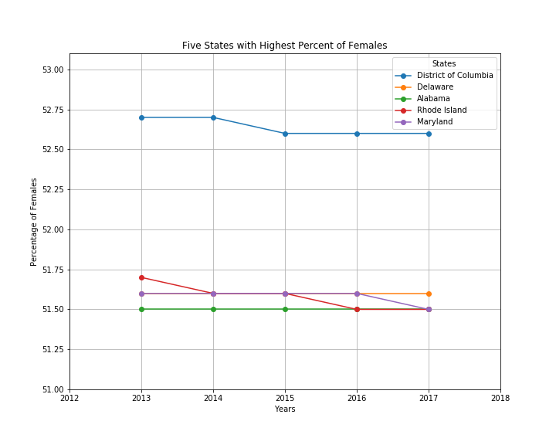

Slide 11
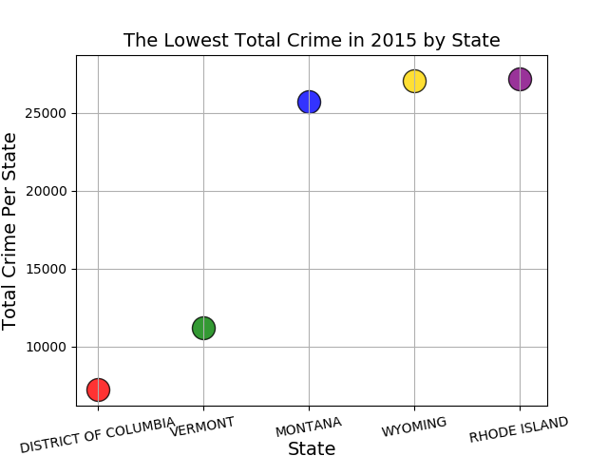

Slide 12
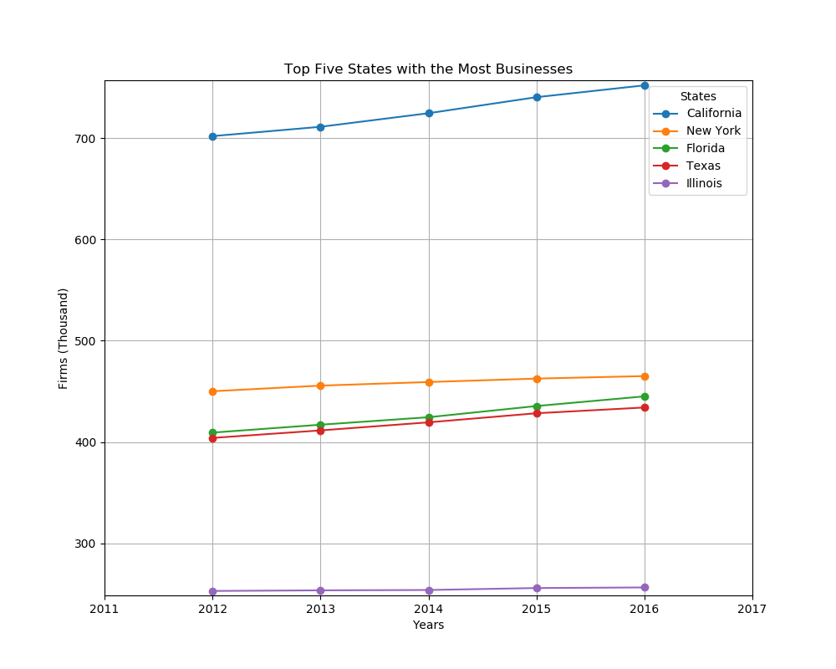

Slide 13
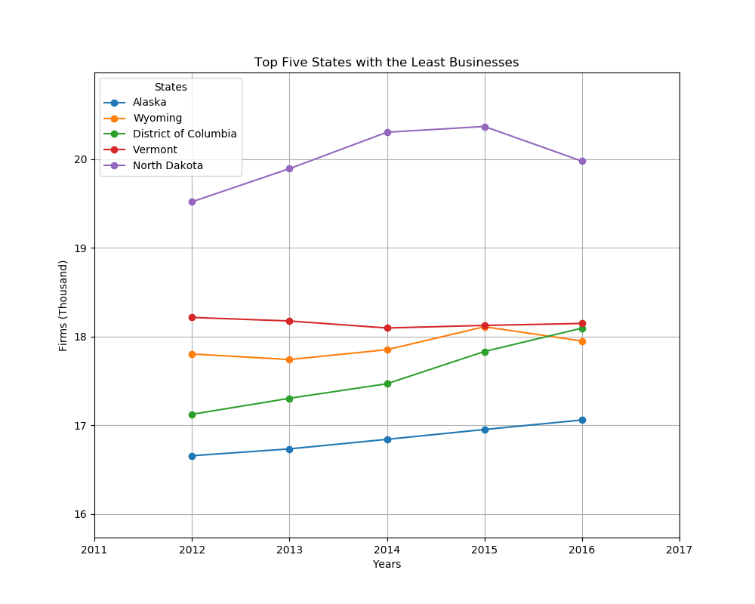

Slide 14
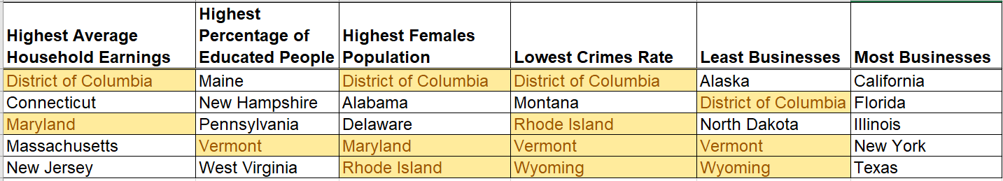
Case Study – Home Cleaning Service
Summary

Slide 15
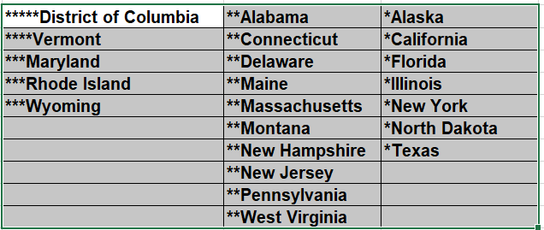
Case Study – Home Cleaning Service
States with Score

Slide 16
Case Study – Home Cleaning Service
Suggestion
Three - Five Stars -> County/City Research
Distance of Low Income -> High Income Neighborhoods
Current Business Industry Revenue/Payroll

Slide 17
Conclusion
Data Finding/Decision
Lesson Learned
Team Dynamic
Project Scope

Slide 18
Dataset Resources
https://catalog.data.gov
https://www.census.gov
https://www2.census.gov
https://factfinder.census.gov

